Slide 1
BeerPal
Final Project
Developers
Daniel Pierce
Andrew Kuo
Brandon Holder
David Lau
Abdikhalid Abdirahman

Slide 2
App Overview
What is it?
BeerPal allows users to search for beers they have tried and rate them on a scale of 0-10.
These beer/rating pairs will go into their personal database.
Key Features:
Beer rating system
Database of beers the user has tried (with rating and other info)
Drink wishlist
Add friends -> send drink recommendations
Beer of the day / trending beers

Slide 3

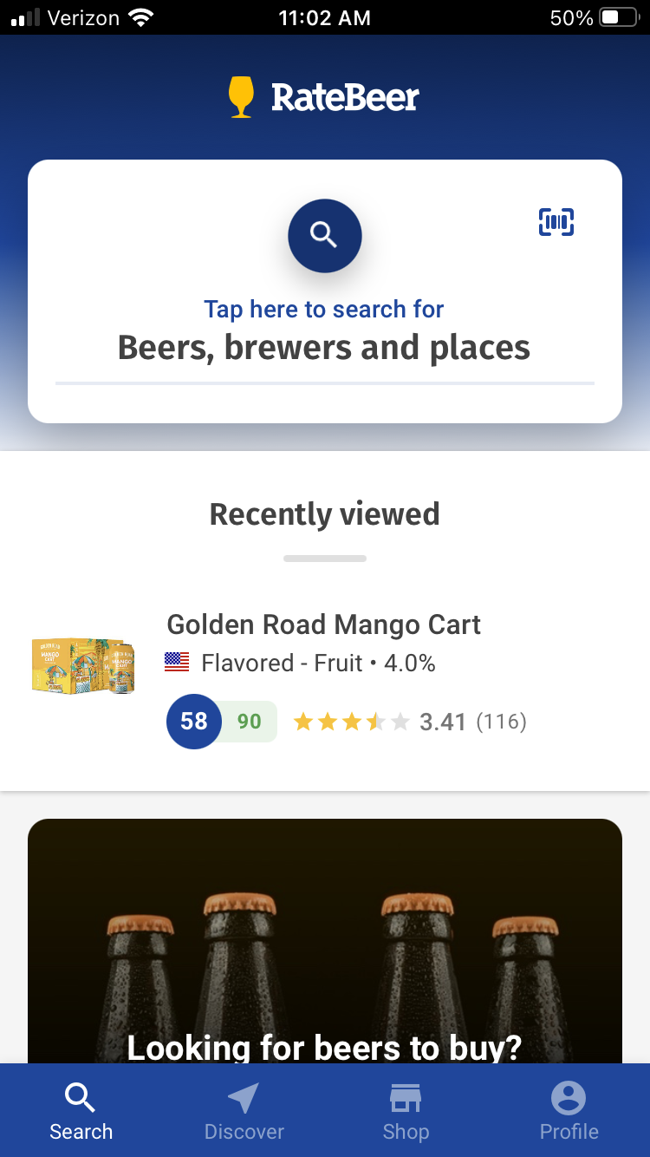
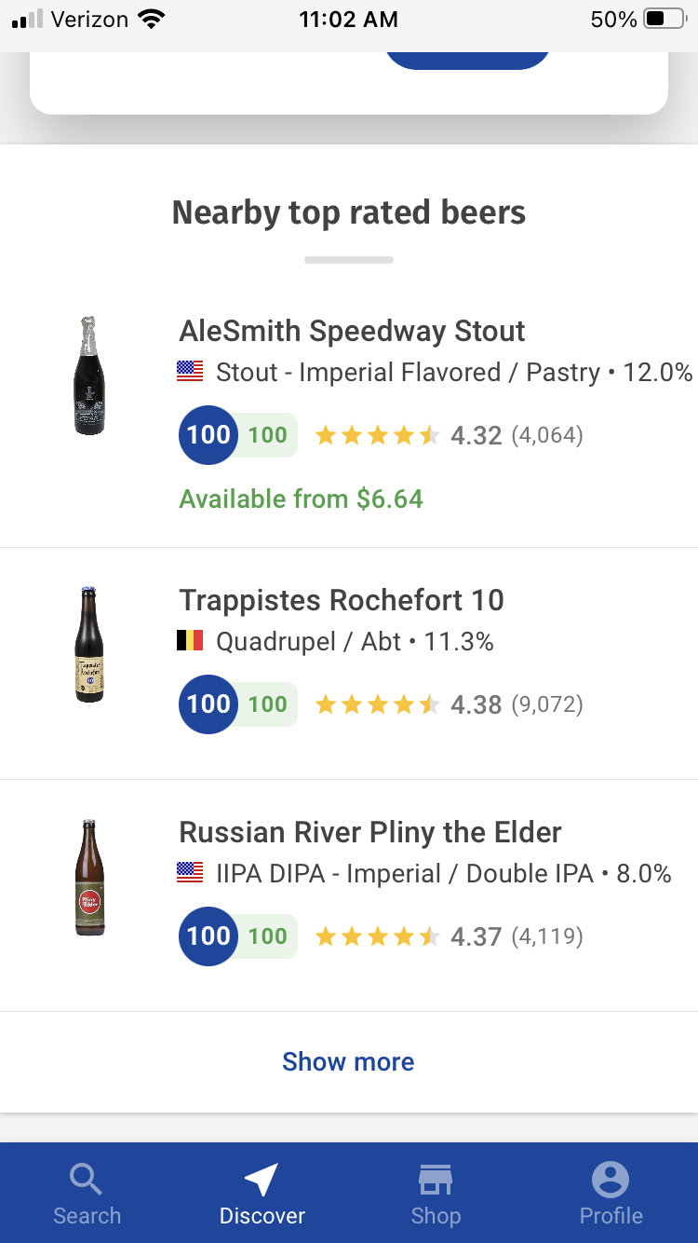
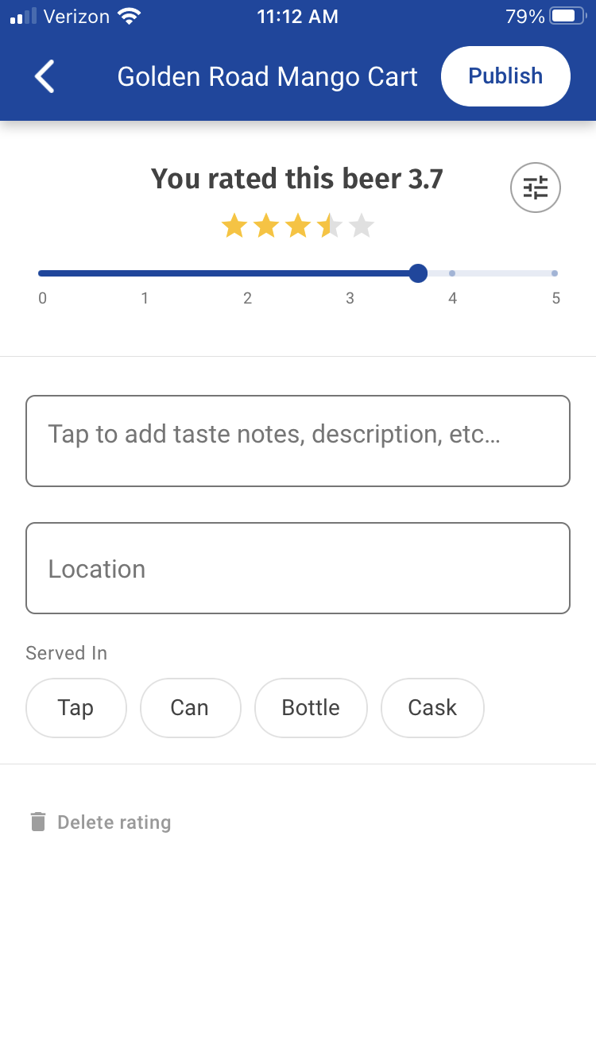
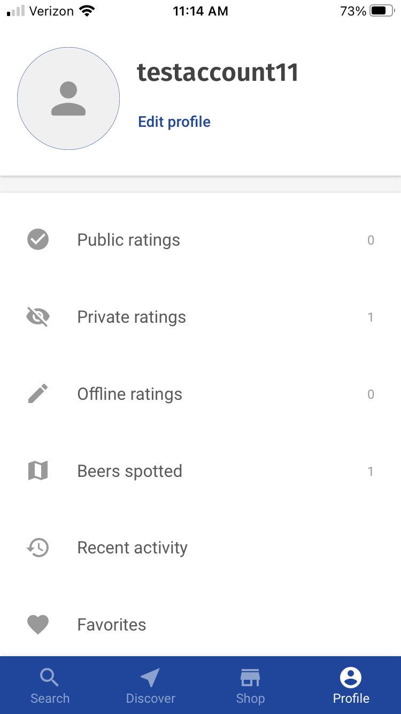
App Competition - RateBeer
Home Page
Top Rated Page
Rating Process
Profile Page

Slide 4
Who is Doing What?
Developers
Daniel Pierce
Profile Activity
Andrew Kuo
Login Activity
Database work
Brandon Holder
Search Beer Activity
David Lau
“What I’ve Tried” Activity
Abdikhalid Abdirahman
Wishlist Activity

Slide 5
Profile Activity
Example from RateBeer
Features:
Profile picture
Edit profile picture
Profile Bio
Edit profile bio
View friends list
Search list / view friend profiles / remove friends
Find friends
Search usernames / add friends
Statistics:
How many beers you’ve tried (within date range)
Most tried beer type (lager/IPA/Hazy/etc.)
Most liked beer type (^)
etc…

Slide 6
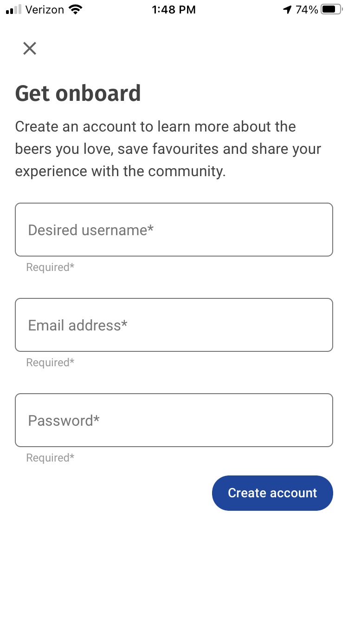
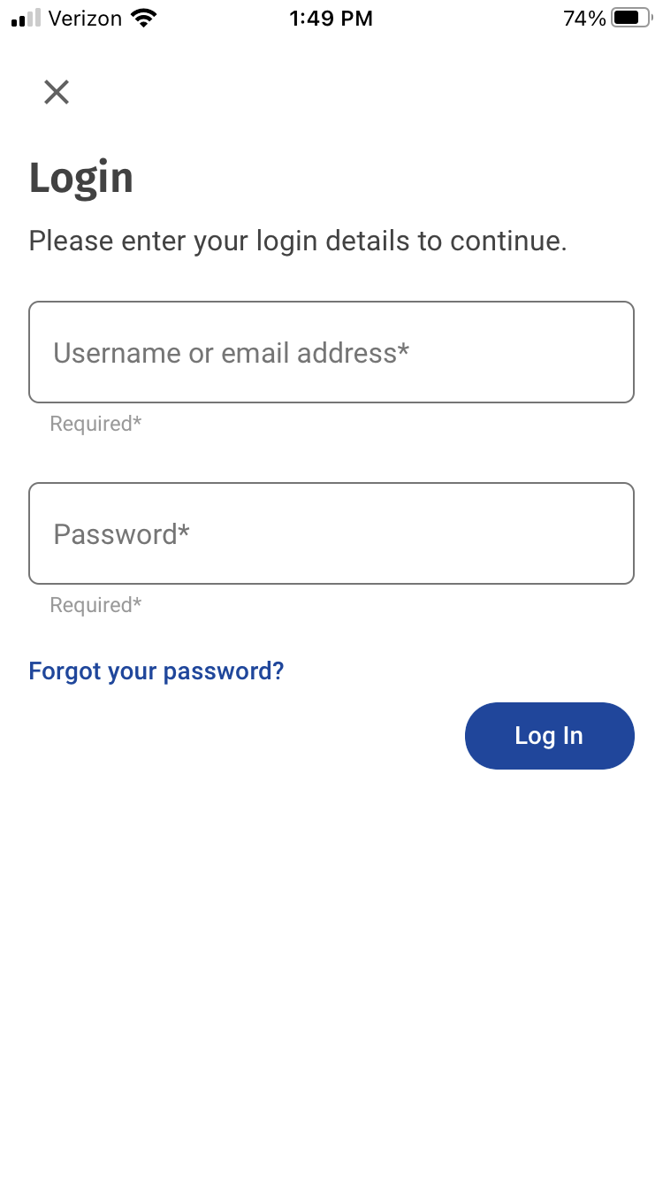
Login/Signup Activity
Create Account Example (RateBeer)
Login Example (RateBeer)
Features:
User can create an account
Social login may be an option (Google/Facebook/Instagram/etc)
User can login
Firebase backend authentication

Slide 7
Search Beer Activity
Features:
Searches database of beers and displays list of results
From search results, the user can:
Rate beer and add to “Beers I’ve Tried” list
Add beer to wishlist
Send beer recommendation to a friend

Slide 8
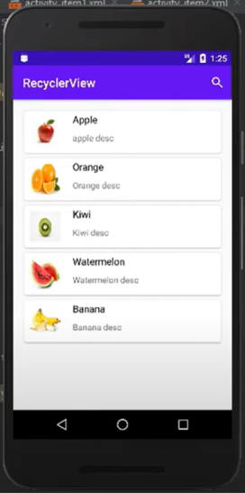
“What I’ve Tried” Activity
Features:
RecyclerView of beers the user has tried/rated
View beer details and rating
Delete items from list
Search the list
Filter list by:
Beer type
Date added
Company name
Beer name

Slide 9
Wishlist Activity
Features:
RecyclerView of wishlisted beers
View wishlist item details
Delete items from wishlist
Search the list
Filter list by:
Beer type
Date added
Company name
Beer name

Slide 10
Summary
Why Our App is Better than RateBeer:
We offer friends lists and recommendations
We offer a wishlist of beers
Challenges:
Getting images/icons for each beer

